Slide 1
Predicting Movie Ratings of IMDB Users
Project Team 3
Xiaoguang Mo (Michael)
Mingyuan Xiao (Amity)
Jingqiu Zhou (Jenny)

Slide 2
Outline: Four Methods
1.Baseline
2.Four Methods
Singular Value Decomposition (SVD)
Item-based Collaborative Filtering (IBCF)
User-based Collaborative Filtering (UBCF)
Combination of User-based Collaborative Filtering (UBCF) and Support Vector Machine (SVM)
3. Conclusion & Recommendation

Slide 3
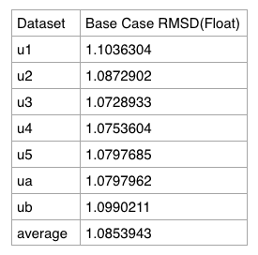
Baseline
We created a baseline as benchmark by computing every user’s average ratings from training set. Then compute the RMSD by comparing to testing set.

Slide 4
1.SVD
Implementation
Demo
Data Analysis & Discussion

Slide 5
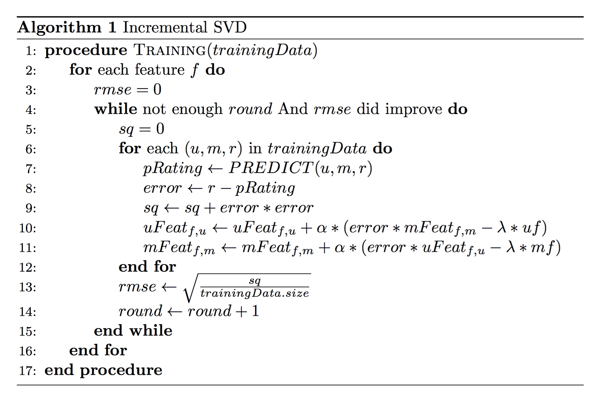
SVD - Implementation (Incremental SVD)
initialize the user/movie feature vectors
training feature one by one, from most significant feature
Notes:
SVD can not function well on missing value, incremental version by using stochastic gradient descent.
only consider existing ratings. (Devised by Simon Funk).
training feature one by one, most significant one first, then next significant one, and so on.
For each feature, loop all training data in several round, and terminate at condition that 1) reached enough round or 2) rmse did not improve
For each training sample, update user feature, movie feature accordingly (based on the formula)
As we can see in the slide, there are essentially 4 parameters adjustable in this alg
initial value/learning rate/regularization parameter/number features
we will examine the effect of those parameters in next couple of slides

Slide 6
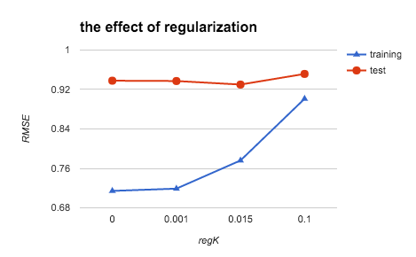
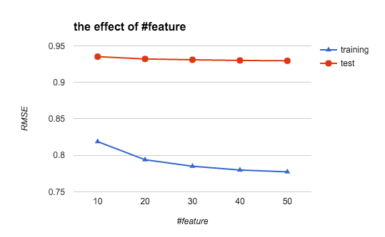
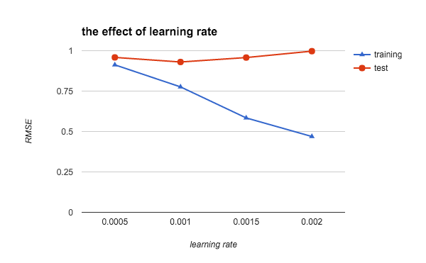
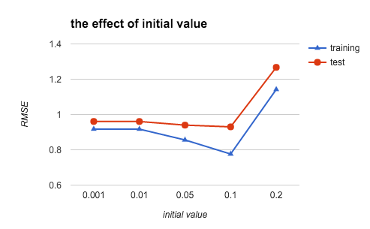
SVD - Data Analysis & Discussion

Slide 7
SVD - Summary
incremental SVD can achieve good RMSE on MovieLen data.
does not need many features, 40-50 features is enough.
initial value & learning rate matters.
overfitting is the problem.
Recommendations:
Too many parameters to tune
Different regularization methods

Slide 8
2. Item-Based Collaborative Filtering
Implementation
Demo
Data Analysis & Discussion

Slide 9
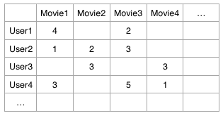
2. IBCF-Implementation
User-Item Rating Matrix
Notes:
SVD can not function well on missing value, incremental version by using stochastic gradient descent.
only consider existing ratings. (Devised by Simon Funk).
training feature one by one, most significant one first, then next significant one, and so on.
For each feature, loop all training data in several round, and terminate at condition that 1) reached enough round or 2) rmse did not improve
For each training sample, update user feature, movie feature accordingly (based on the formula)
As we can see in the slide, there are essentially 4 parameters adjustable in this alg
initial value/learning rate/regularization parameter/number features
we will examine the effect of those parameters in next couple of slides

Slide 10
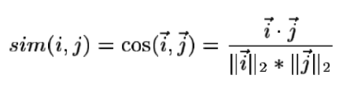
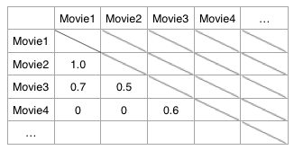
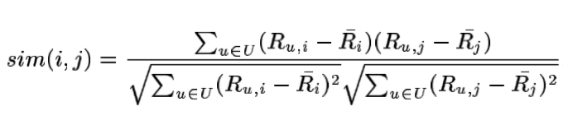
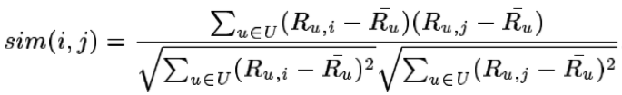
Item-based Collaborative Filtering
Item-Item Similarity Matrix

Slide 11
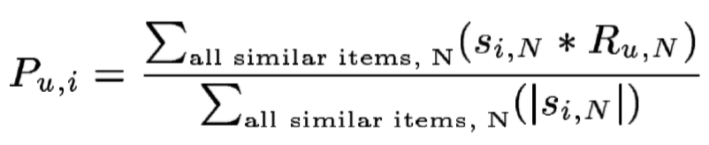
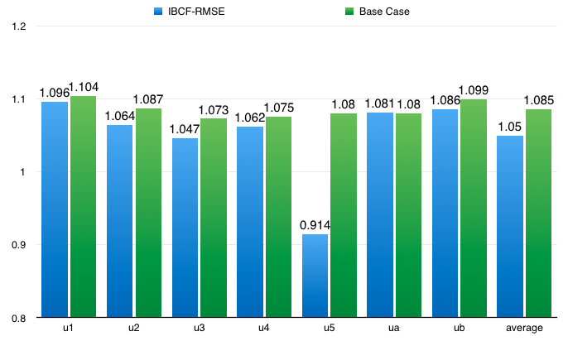
Item-based Collaborative Filtering

Slide 12
3.User-based Collaborative Filtering
Design
Demo
Data Analysis & Discussion

Slide 13
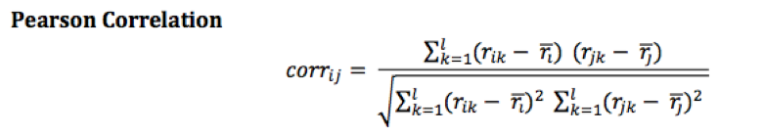

USCF- Design
Screenshot 2016-03-19 10.44.22
Improvement:

Slide 14
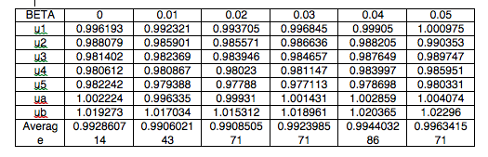
USCF- Data Analysis & Discussion
Demo
Results:
Notes:
SVD can not function well on missing value, incremental version by using stochastic gradient descent.
only consider existing ratings. (Devised by Simon Funk).
training feature one by one, most significant one first, then next significant one, and so on.
For each feature, loop all training data in several round, and terminate at condition that 1) reached enough round or 2) rmse did not improve
For each training sample, update user feature, movie feature accordingly (based on the formula)
As we can see in the slide, there are essentially 4 parameters adjustable in this alg
initial value/learning rate/regularization parameter/number features
we will examine the effect of those parameters in next couple of slides

Slide 15
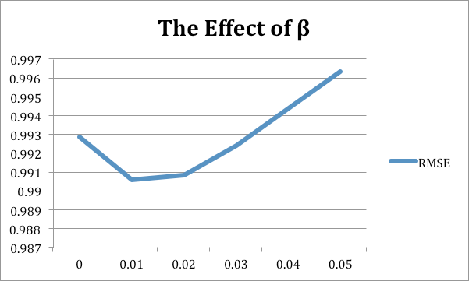
USCF- Data Analysis & Discussion
Parameter β
Notes:
SVD can not function well on missing value, incremental version by using stochastic gradient descent.
only consider existing ratings. (Devised by Simon Funk).
training feature one by one, most significant one first, then next significant one, and so on.
For each feature, loop all training data in several round, and terminate at condition that 1) reached enough round or 2) rmse did not improve
For each training sample, update user feature, movie feature accordingly (based on the formula)
As we can see in the slide, there are essentially 4 parameters adjustable in this alg
initial value/learning rate/regularization parameter/number features
we will examine the effect of those parameters in next couple of slides

Slide 16
4. Combination of User-based Collaborative Filtering and Support Vector Machine (UBCF & SVM)
Design
Data Analysis & Discussion

Slide 17
UBCF & SVM - Design
1. User-based Collaborative Filtering
2. Support Vector Machine a) Data Preprocessing
Format: <rating> 1:<u_p_score> ...23:<is_western_genre> b) Train SVR Based on this new dataset, we use libsvm to train a SVR model c) Predict Use the SVR model to predict the result.
Notes:
1st Step: User-based Collaborative Filtering Firstly, we need to implement User-based Collaborative Filtering so that we can represent the features of the relationships between users and movies. This method has been successfully implemented. 2nd Step: Support Vector Machine a) Data Preprocessing Use the User-based Collaborative filtering method in the to predict the ratings for training data. Consider user and movie meta information such as user_age, user_gender, user_occupation, movie_genre. We combine all these information and generate the processed training data and test data in below format: <rating> 1:<u_p_score> 2:<u_age> 3:<u_gender> 4:<u_occupation> 5:<is_unknown_genre> 6:<is_action_genre> 7:<is_adventure_genre> 8:<is_animation_genre> 9:<is_children’s_genre> 10:<is_comedy_genre> 11:<is_crime_genre> 12:<is_documentary_genre> 13:<is_drama_genre> 14:<is_fantasy_genre> 15:<is_film-Noir_genre> 16:<is_Horror_genre> 17:<is_ Musical_genre> 18:<is_Mystery_genre> 19:<is_romance _genre> 20:<is_sci-fi_genre> 21:<is_thriller_genre> 22:<is_war_genre> 23:<is_western_genre> From feature 5 to the feature 23, the output is Boolean value, which is represented by 0 or1, where 0 represents the movie is not in a genre, while 1 means movie is in that genre. b) Train SVR Based on this new dataset, we use libsvm to train a SVR model c) Predict Use the SVR model to predict the result. In this way, we successfully predict the movie ratings.

Slide 18

UBCF & SVM - Data Analysis & Discussion
initialize the user/movie feature vectors
training feature one by one, from most significant feature
Notes:
Too much time is spent on training the data. However, results of three datasets have been generated by SVM machine.

Slide 19
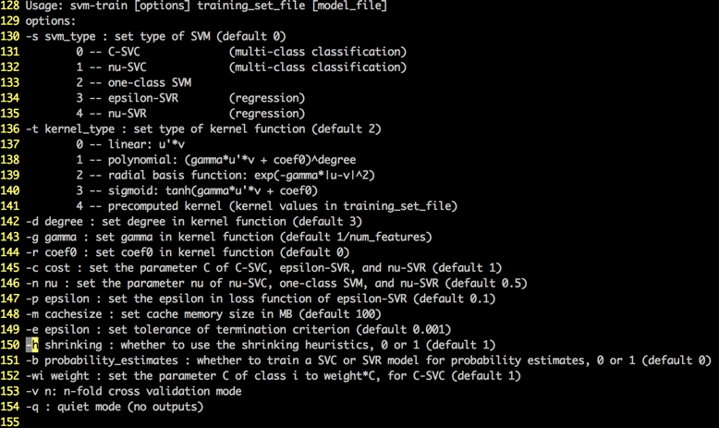
UBCF & SVM - Data Analysis & Discussion
Libsvm:
Default Parameters
Notes:
we once expect the results of this method would be the best. However, in reality, the results are not as good as what we expected. We guess the reason is that we use the default parameters of libsvm, which make the results not so good. In the future, we may adjust the parameters below in order to generate better results.

Slide 20
Discussion & Conclusion
All the four methods are Better Than Baseline!!!
Characteristics of the Four MethodS:
SVD: 40-50 features is enough.
IBCF: No Parameter is needed.
UBCF Regularization parameter β (around 0.01 in this dataset)
UBCF & SVM :Main Challenge is to find the right parameters
Notes:
From what we presented above, we can find that all…….

Slide 21
Recommendations For Future Studies
Main Purpose: Predict Movie ratings
False Negatives and False Positives
Optimize Methods
E.g., SVD: Not Considering Hot Movies, UBCF & SVM: Adjust Parameters
Notes:
The purpose of rating movies is to recommend movies to the users. Normally we use a threshold such as 3.5 to recommend movies to the users. However, it will still cause some false negatives and false positives values. Therefore,we still can optimize the methods to predict the users’ ratings closer to the actual ratings. In the future work, several aspects can be improved. As for IBCF, for some special corner cases like predicting of the user who never appear in training datasets or movie that never exists in training datasets, IBCF could use some special technology to give a rough prediction only based on the similarity of different movies. When recommending the movies to the users, the reference information of some of the hot movies is not so useful, because the users may rate those movies according to the Media’s preference instead of themselves. Therefore, in the future work, without considering the hot movies, we can test the program to see if the result can better predict the users actual ratings.

Slide 22
Thank you

